Slide 1
WEB SCRAPING USING R
MOLECULAR CANCER
Ayush Dewan (ad2293)
Prajay Patil (pp923)
Palak Pabani (pp872)
Professor: Jaini Bhavsar| Course: DS636 | Date: 11-11-2023

Slide 2

INTRODUCTION
Data scraping involves extracting information from websites or other sources on the internet. It's a technique used to gather data for analysis, research, or other purposes.
Data scraping plays a crucial role in accessing and utilizing valuable information available on the web. It allows for the collection of diverse data sets for various analytical purposes.

Slide 3
Code Explanation
We install all the essential libraries required for web scraping.
We copy the main URL and read the html code in a variable.
We go to webpage and get the CSS selector for the required field.
We create a function to extract key fields from the webpage.
After extracting all the required fields we combine them in a dataframe.
Now we clean the data, we remove all the missing values and format the data for analysis.
For doing the analysis we use library ‘ggplot’ and create the graph for the required analysis.

Slide 4
Our Code
This is the function we have used for web scraping
get_date<- function(journal_link) {
journal_page <- read_html(journal_link)
journal_date <- journal_page %>% html_nodes(".c-article-identifiers__item time") %>%
html_text() %>% paste(collapse = ",")
return(journal_date)
}
Similarly we have done the data scraping for the other fields

Slide 5
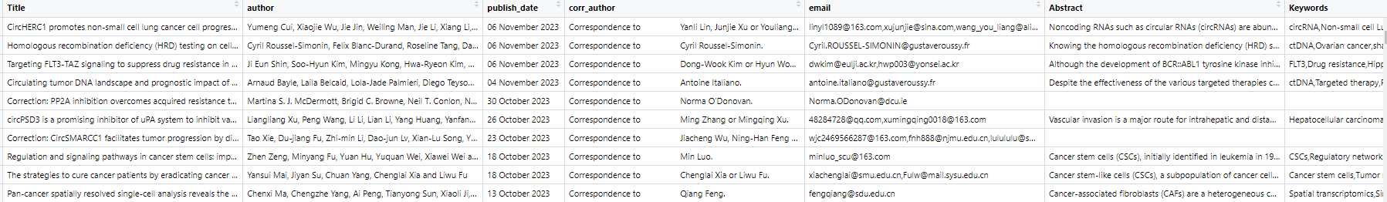
Data frame
df <- rbind(df,data.frame(Title, author,publish_date,corr_author,email, Abstract,Keywords)) This method we have created the dataframe.

Slide 6
Data analysis
For the data analysis part, we have used library ggplot and created a bar graph for number of articles published in the year.
First we extracted the year from the published date using regex.
Then we plotted the graph using this code.
ggplot(year_counts, aes(x = year, y = Count)) +
geom_bar(stat = "identity", fill = "blue") +
labs(title = "Year Counts", x = "Year", y = "Count")

Slide 7
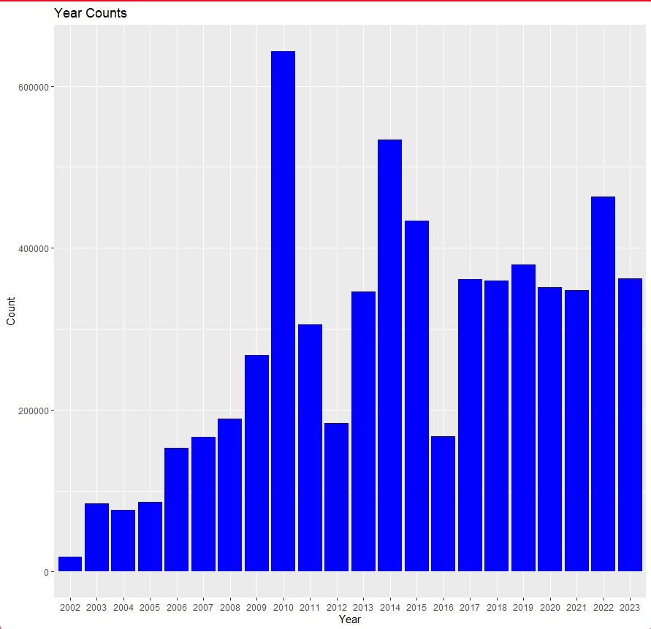
Graph

Slide 8
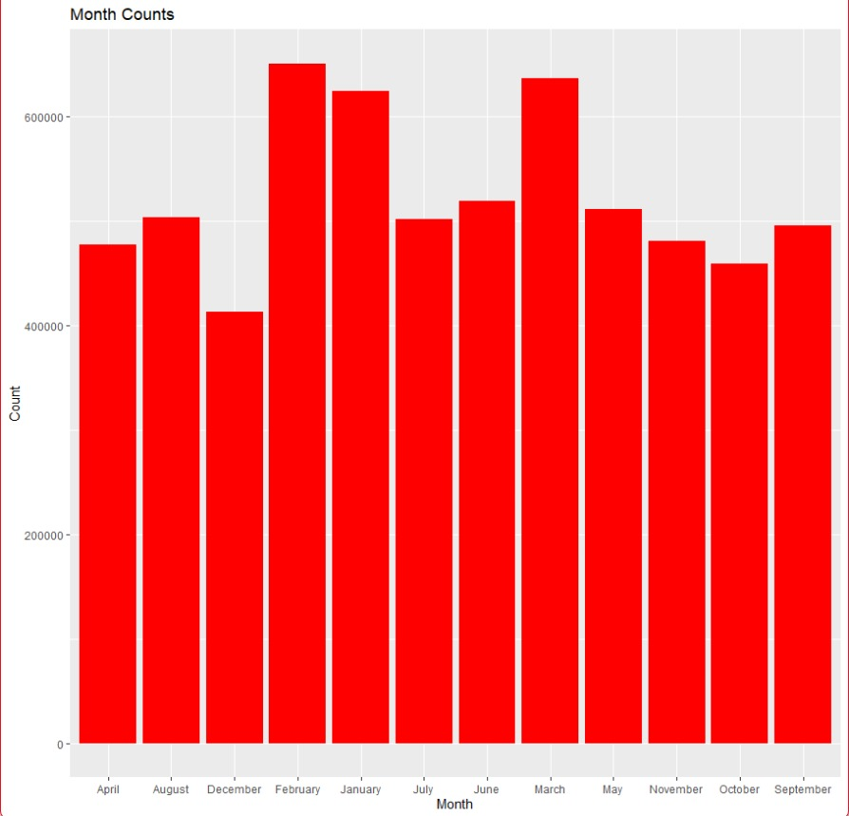
Graph

Slide 9
Challenges
Extracting the data was a challenge and writing functions to loop through each page efficiently
Extracting the email of the corresponding authors via the hyperlink was a challenge
Trying to write a code which was efficient enough to extract all the data before SSL/TLS connection timeout.
Ensuring adherence to data privacy and ethical considerations was paramount. Strategies were implemented to respect website terms of service and avoid any unintended violations.
Crafting informative and visually appealing visualizations.

Slide 10
Individual member contribution
Data Scraping – Prajay P.
Analysis and Visualization – Ayush D.
Presentation and fine tuning – Palak P.

Slide 11
Thank You

